Slide 1

Book one-way outstation Cab & Display the Lowest charges.
Hackathon – Team1
SPIDEY TESTERS.

Slide 2
REQUIREMENTS-MODULE 1
LAUNCH THE Make My Trip WEBSITE
(“https://www.makemytrip.com/”)
Search for cabs from Delhi to Manali, with pickup at 6:30AM for future date.
Select car Type as SUV and display the lowest charges

Slide 3
MODULE 2
Select Gift card
(Corporate Gift cards).
Enter the user details in the E-Mail Section with invalid email id.
Capture and display the error message.

Slide 4
MODULE 3
Select HOTELS.
Select Adults counter.
Get the list.

Slide 5
SCOPE & PLAN OF THE PROJECT
1. Manually tested the website based on the requirements.
2. Functional testing was carried out.
3. Automation was carried.
4. TestNG was invoked with smoke and Regression suites.
5. Extent Report, Readme Documents and Power Point Presentation was done.

Slide 6
TOOLS & TECHNOLOGIES USED
1. Selenium-java : 4.0.0
2. Maven : 4.0.0
3. Apache : 4.1.2
3. WebdriverManager : 4.4.3
4. Extentreports : 3.1.5
5. TestNG : 7.1.0

Slide 7
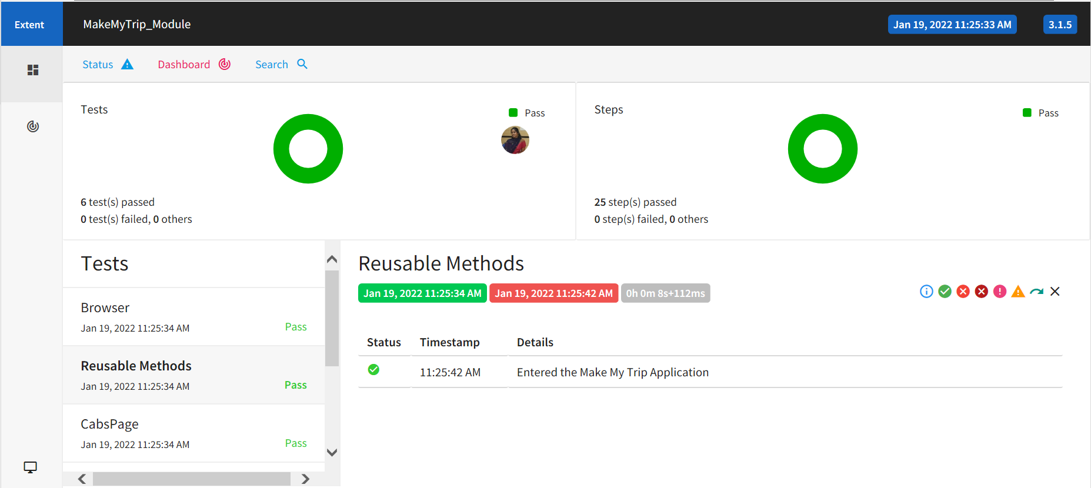
EXTENT REPORT

Slide 8
“SPIDEY TESTERS” MEMBERS
1. Ajay D
2.Dhanush K
3.Nithiyashree R
4.Pradeep S
5.Renuga K
6.Soundarya S

